Slide 1

Chat Bo-Tech
Graduation Project 2023-2024

Slide 2

Supervied By:
Dr.Rodaina Abdelsalam
Eng. Aya Magdy

Slide 3
Team Member
01
02
03
04
Philopater Shenouda
20-00578
Mohamed Ahmed
20-00145
Shaker Emad
20-00336
Mohamed AlFaramawy
20-00660
05
06
07
Abdulrahman Zakaria
20-01613
Ibrahim Abdeltawab
20-01508
Khald Ashraf
20-01975

Slide 4
Abstract
This project introduces a specialized e-commerce platform for selling laptops, featuring an intelligent Chabot.
Additionally, users can explore and purchase laptops along with exclusive accessories through the user-friendly online store interface, enhancing the overall shopping experience.
Leveraging artificial intelligence, the project ensures accurate and personalized recommendations for both laptops and associated accessories.

Slide 5
Outline
Introduction
Problem Statement
Related Work
Methodology of Proposed Approach
Research Objectives
Time Plan
Conclusion
Future Work
References

Slide 6
01
Introduction

Slide 7

Introduction
This project offers an innovative platform for purchasing laptops, featuring a chat bot that provides personalized recommendations to users of all knowledge levels. The site combines ease of use, cutting-edge technology and personalized assistance, simplifying the laptop selection process. The platform aims to create an enjoyable journey for the user in finding the right device.

Slide 8
02
Problem Statement

Slide 9

Problem Statement
The primary objective is to offer a solution for individuals within this group who find it challenging to navigate the laptop selection process. Through the development of an easy-to-use platform equipped with an intelligent chat bot, our project seeks to empower users with limited experience in choosing laptops.

Slide 10
03
Related Work

Slide 11
Paper 1
A Comprehensive Analysis of Recommendation System for ECommerce Mobile App using various Algorithms
2021
Collaborative , Content-based and K-means
E-commerce websites use recommendation systems to suggest products to customers, based on their browsing history and other data, to increase sales and offer personalized deals. This paper explores how these systems work

Slide 12
Paper 2
Content Based Movie Recommendation System
2020
Content Based
This research proposes a movie recommendation system using a single score combining cast, keywords, crew, and genres to suggest movies users might enjoy, aiming to save them browsing time and cater to their preferences based on previously liked movies

Slide 13
Paper 3
Recommender System in eLearning: A Survey
2020
Content Based and Collaborative-filter and K-Means
This research proposes an "e-learning task recommender" system using user profiles and access patterns to suggest relevant learning tasks to students, addressing the issue of finding appropriate learning content amidst vast resources.

Slide 14
Paper 4
Implementation K-Means Clustering Method in Job Recommendation System
2021
K-Means Clustering
This research proposes a K-Means Clustering-based job recommendation system for fresh graduates, matching them to suitable vacancies based on skills, salary, and location

Slide 15
RELATED WORK
Some features are NOT found in Amazon :
Chat Bo-Tech | Amazon
Our site features a smart chatbot that provides personalized guidance to users in selecting the right laptop. | Amazon may have chat support, but they may not offer a similar level of personalized guidance.
We have a specific focus on the laptop category, meaning we provide tailored recommendations and carefully curated products in this field. | Amazon covers a wide range of products and categories, which may make the specific focus on laptops less prominent

Slide 16
RELATED WORK
Some features are NOT found in B.TECH :
Chat Bo-Tech | B.TECH
Our website prioritizes simplifying the laptop selection process and overall shopping experience, offering a seamless experience for users.. | B-tech interface may be more complex due to the diversity of products and services they offer..
Our site provides comprehensive specifications and comparison tools for laptops.. | B-tech may not have as detailed specifications or specialized comparison tools for laptops.

Slide 17

04
Methodology of Proposed Approach 1-ML 2-Web app

Slide 18

Used algorithm
Content-based
K-means

Slide 19
Content-Based Filtering
User Profile Creation
Profile Preferences
User
Processing
Similarity Calculation
Processing
Extracting Information
Items
Dataset
Weighted Similarity
Recommendation Display
Print
Top Matches
Selection

Slide 20
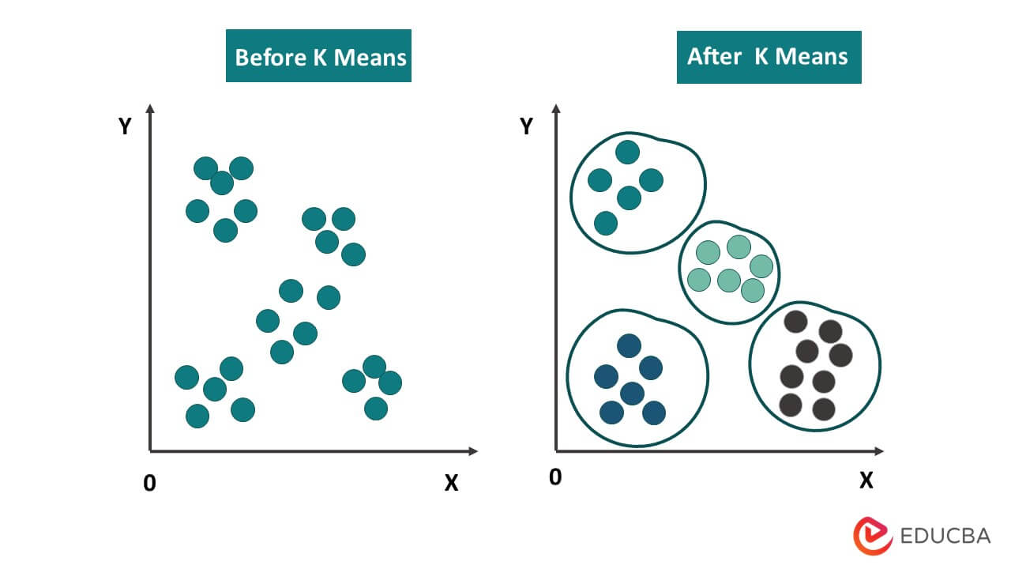
K-means
K-means helps cluster products based on similarity
By grouping products with similar feature, , leading to faster recommendation generation and enhancing overall system performance.

Slide 21
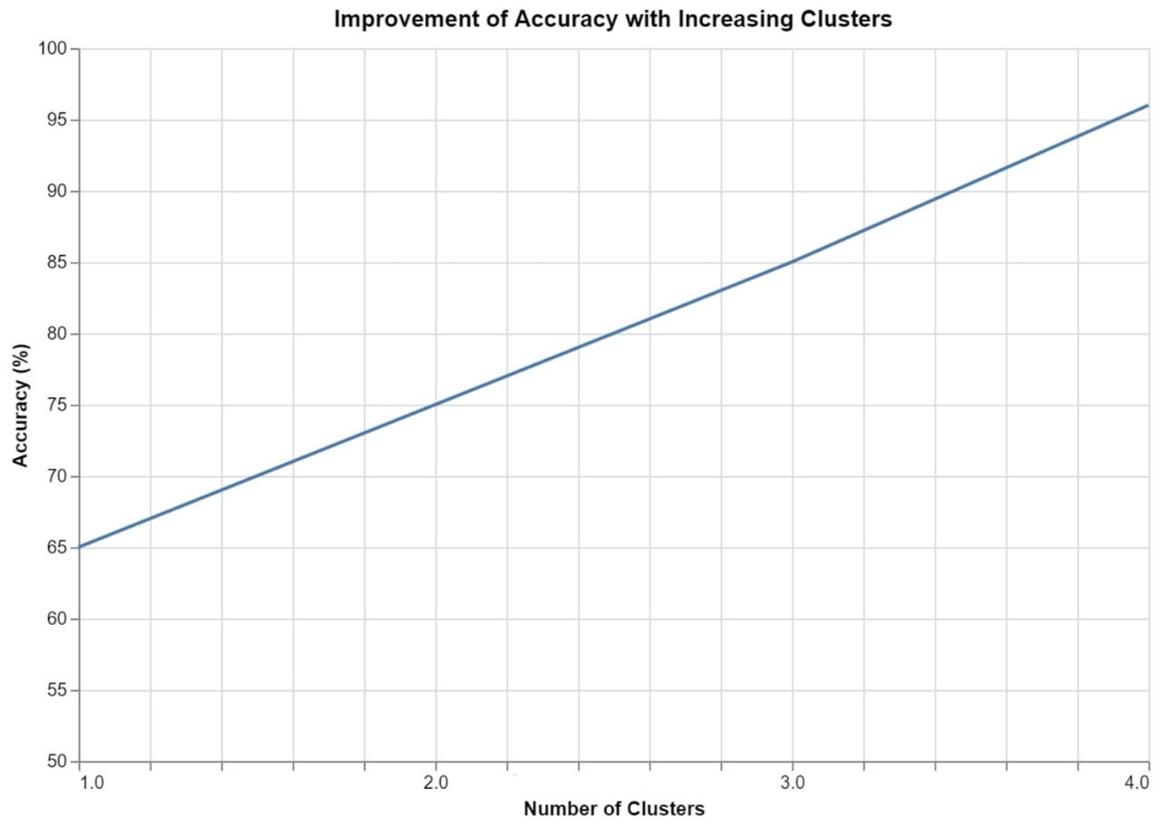


Accuracy
After clustering the data, there was a notable improvement model to accuracy 97%, enabling more efficient analysis with reduced dataset size.
enhancing both performance and prediction.

Slide 22
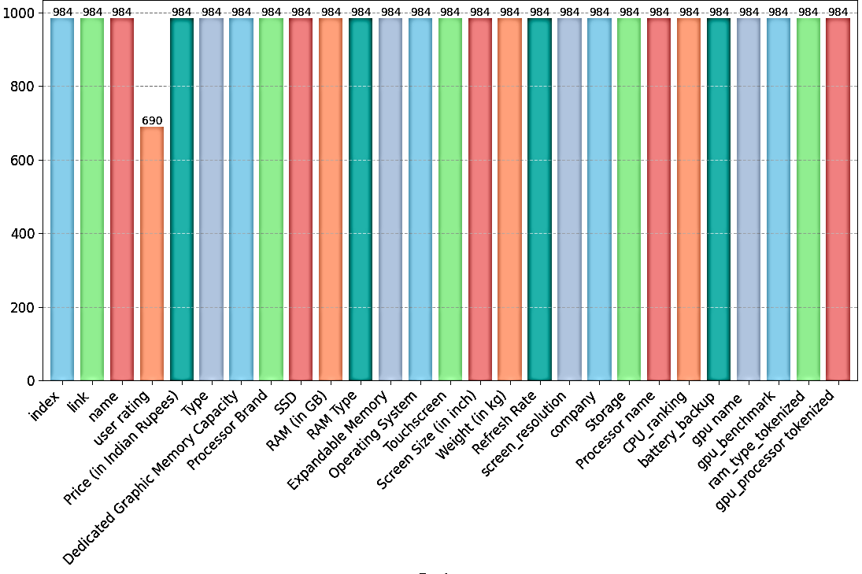
Dataset
The dataset is the laptop listings an ecommerce website in India corresponding laptop's CPU ranking and GPU benchmarks. The dataset has 26 features (Ex: Laptop name, link to buy, price in Indian rupees, processor, GPU, processor ranking, GPU benchmark, etc.)

Slide 23
Methodology Of Web
Front end
Back end
Figma
Html
Css
Booststrap
JS
Php
My -Sql

Slide 24
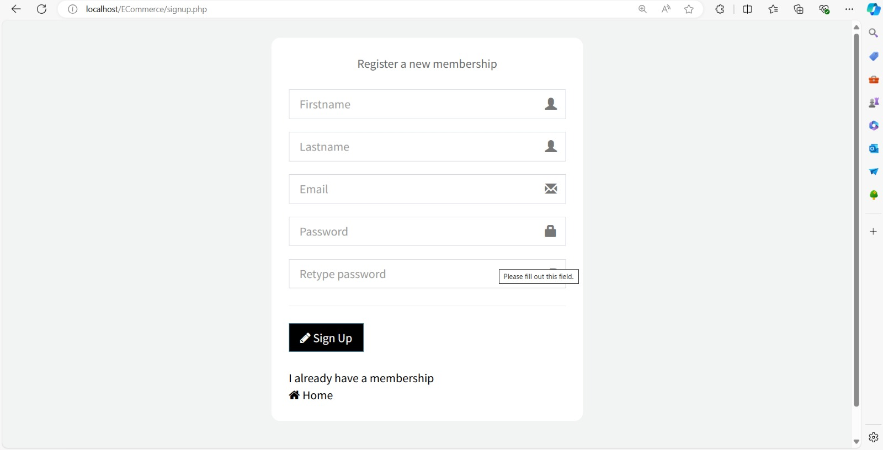

Slide 25
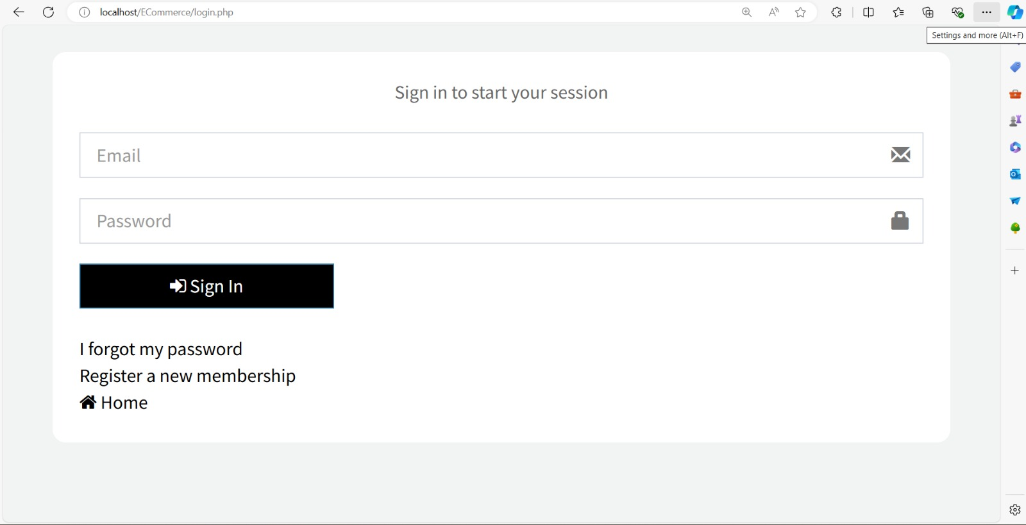

Slide 26
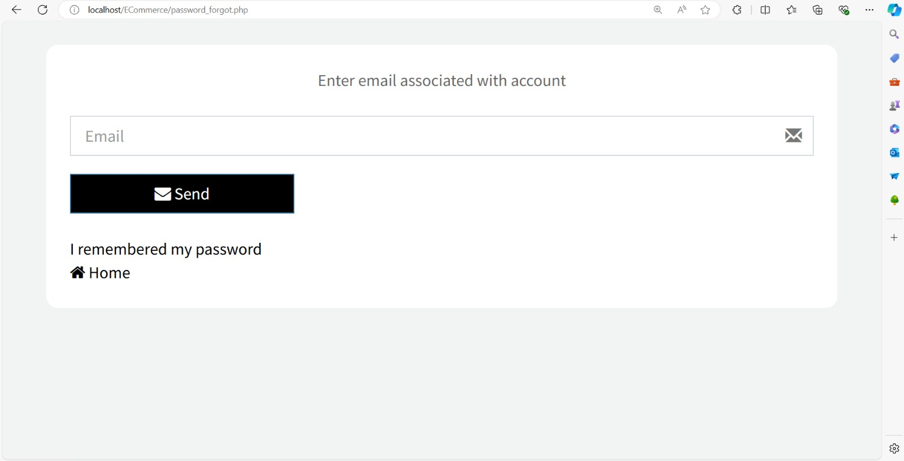

Slide 27
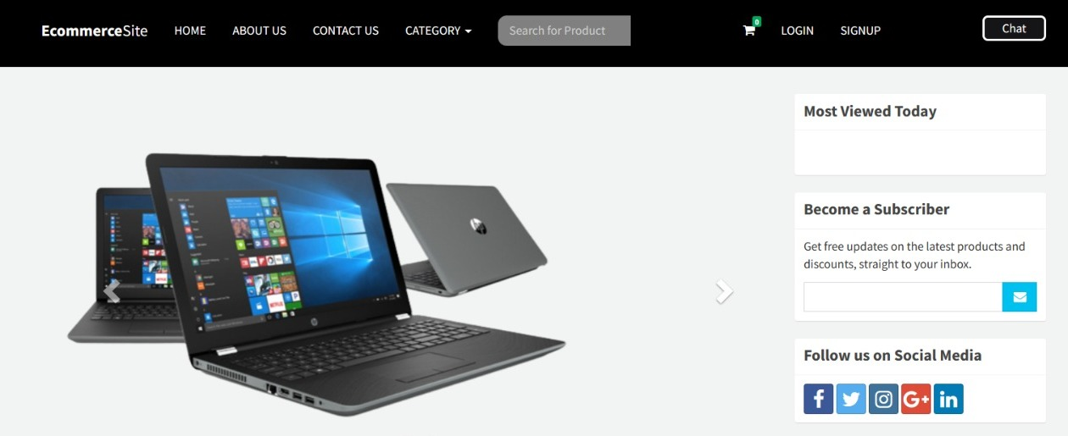

Slide 28
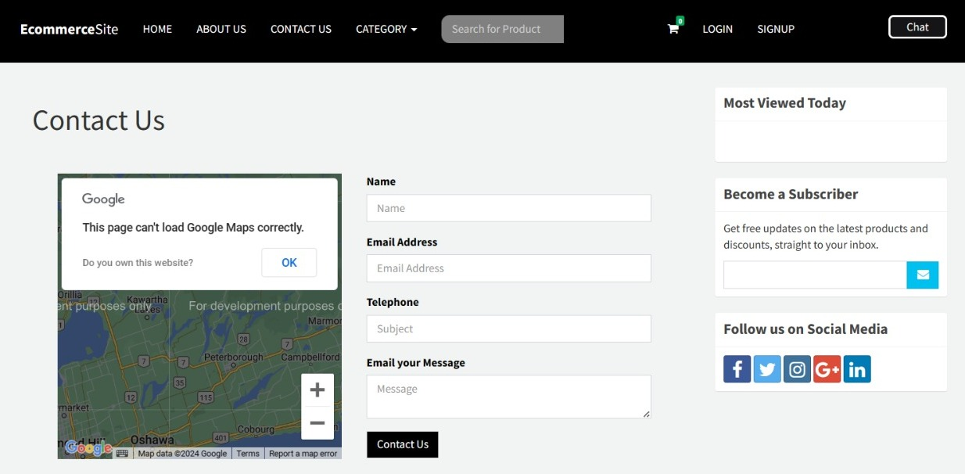

Slide 29
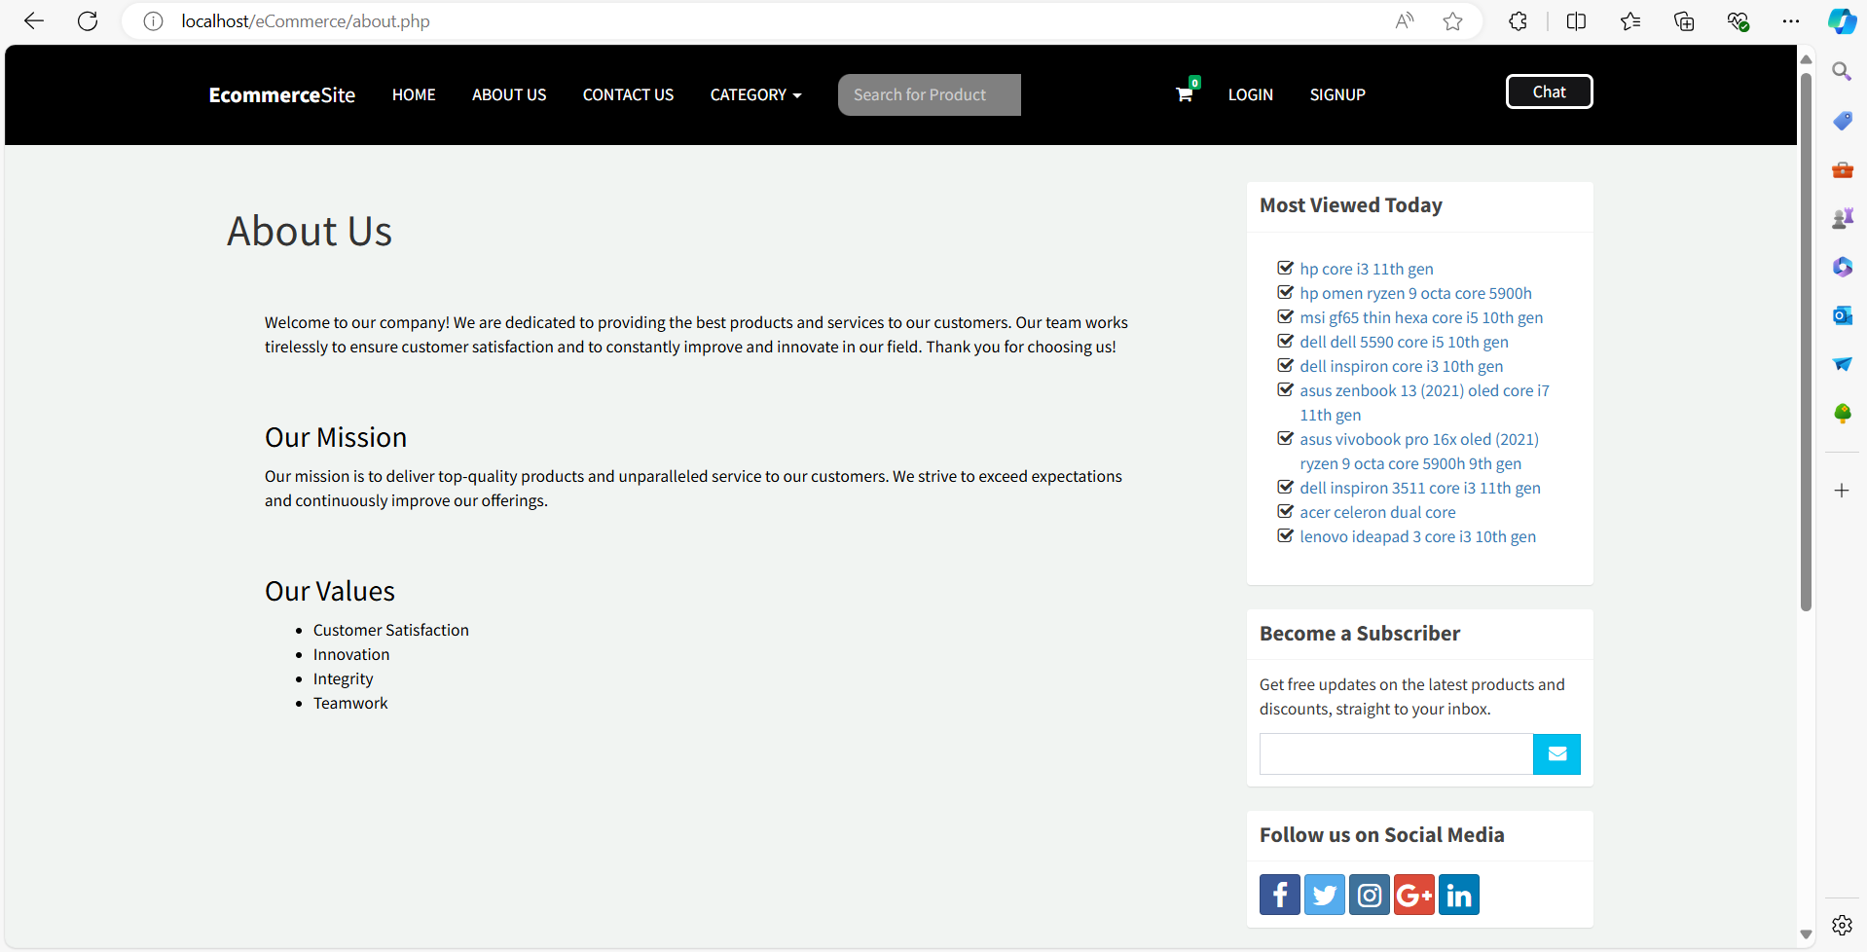

Slide 30
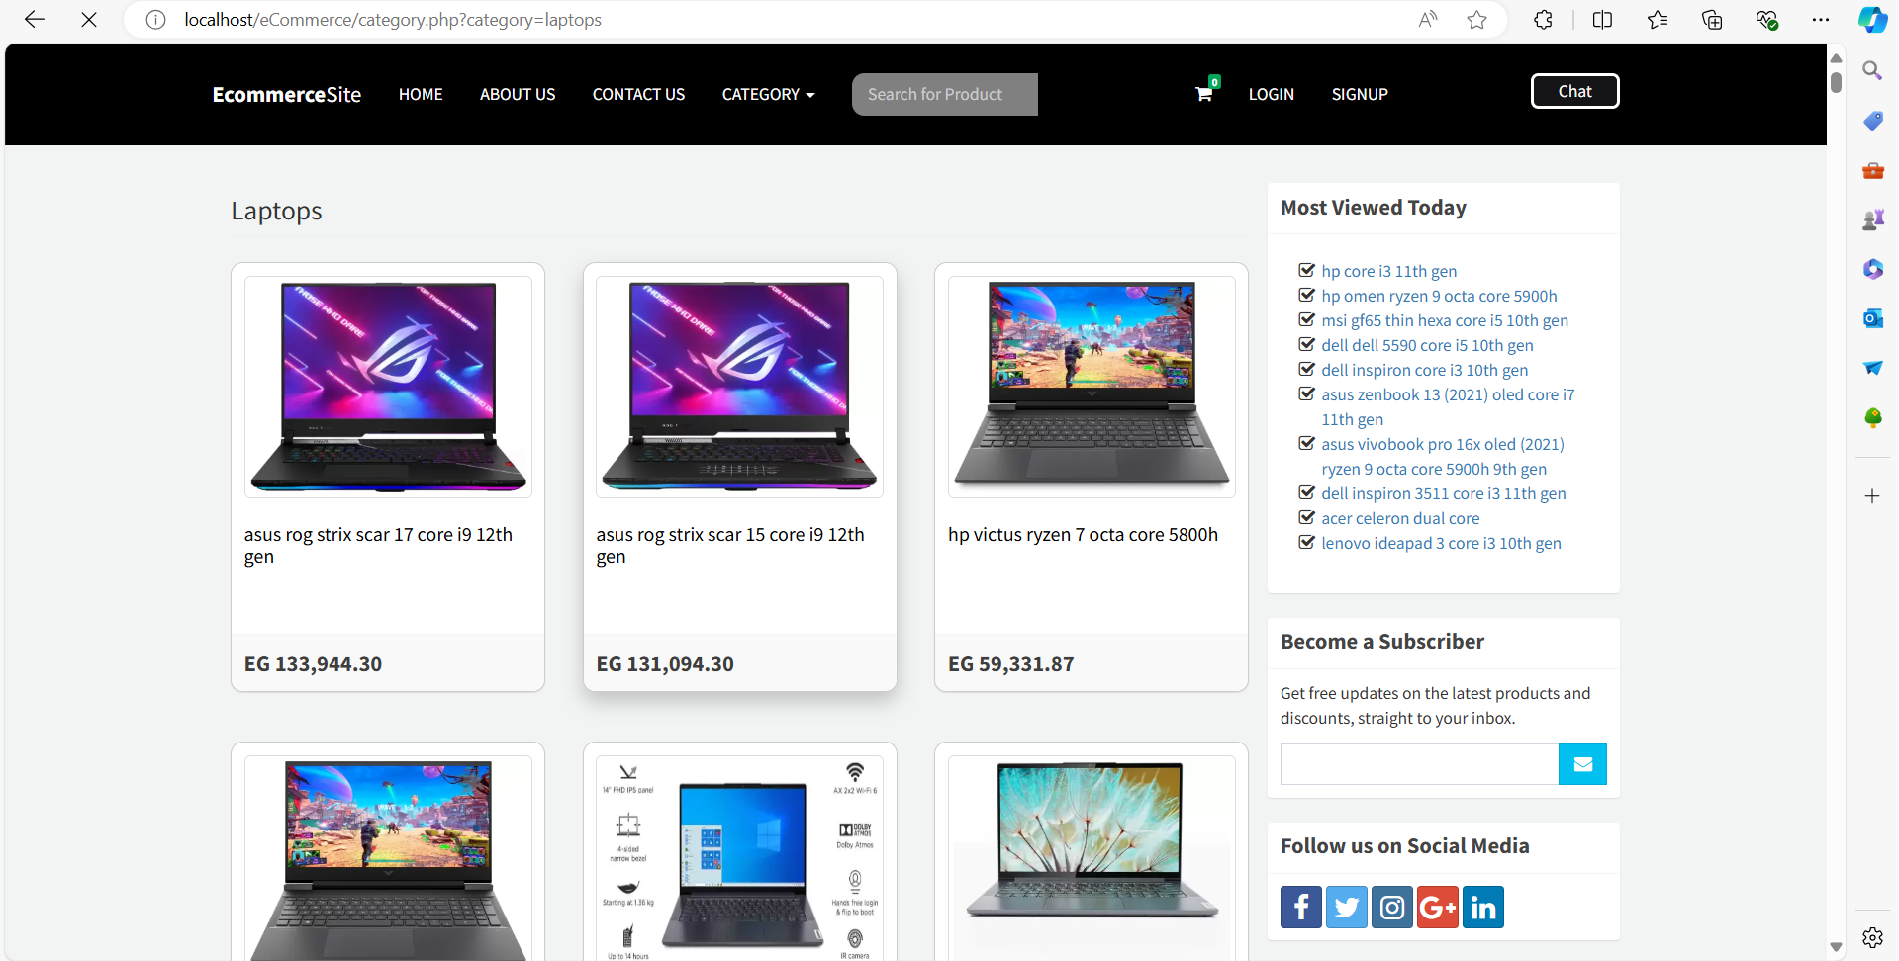

Slide 31
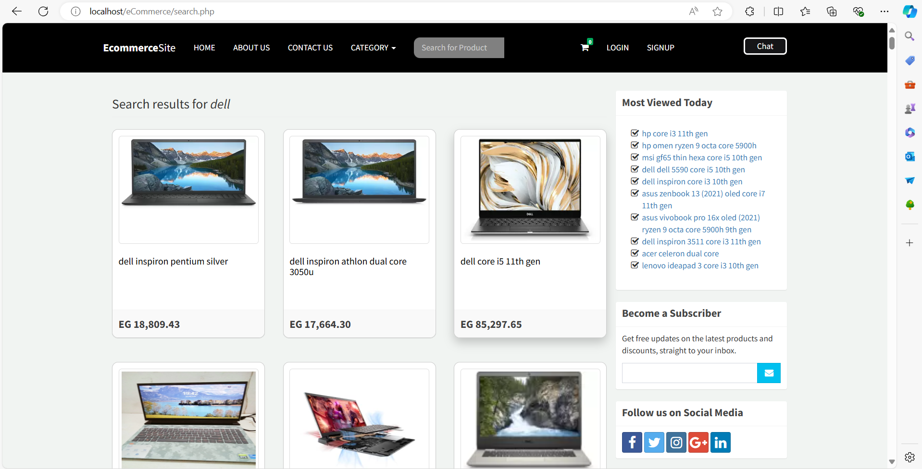

Slide 32
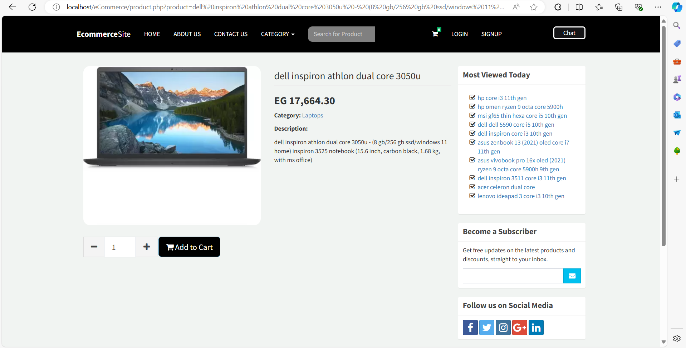

Slide 33
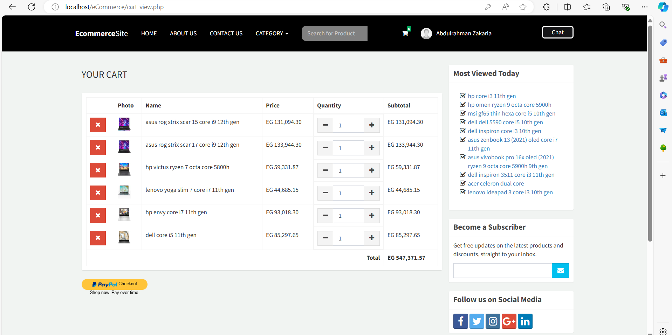

Slide 34
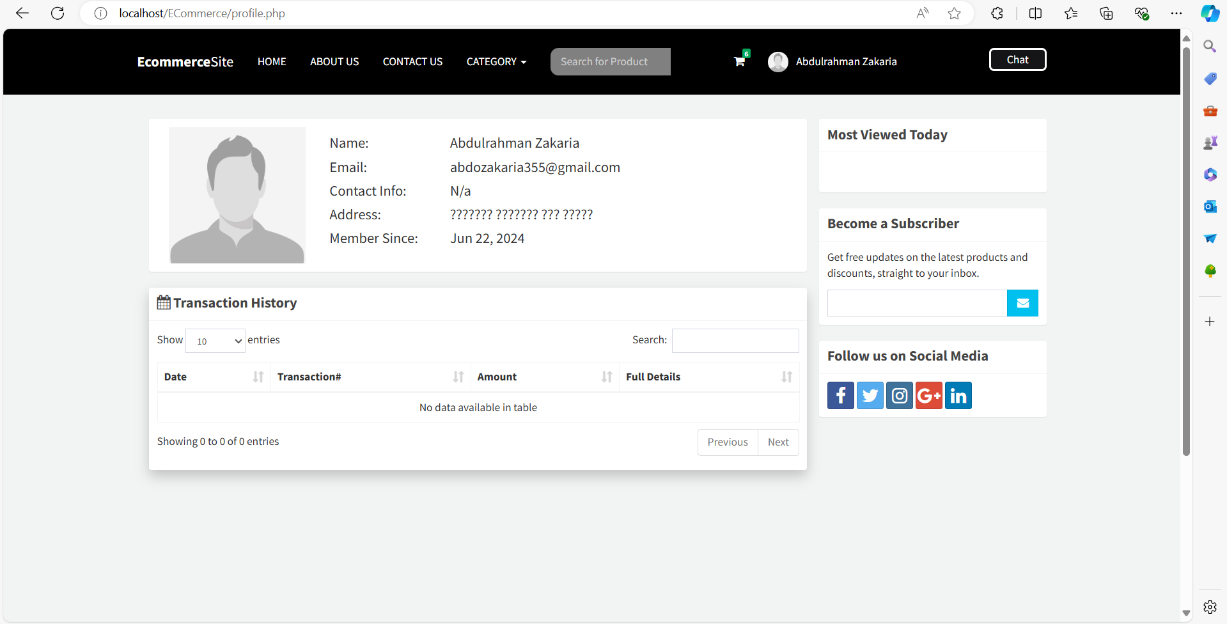

Slide 35
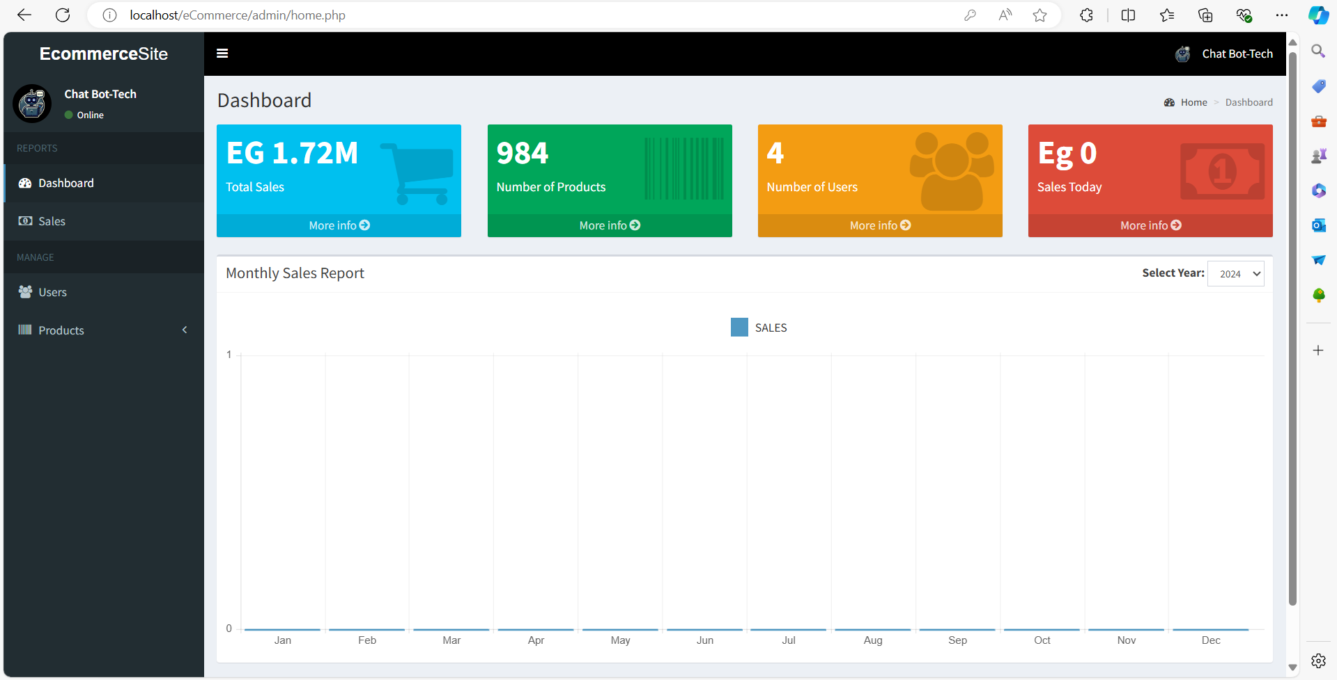

Slide 36
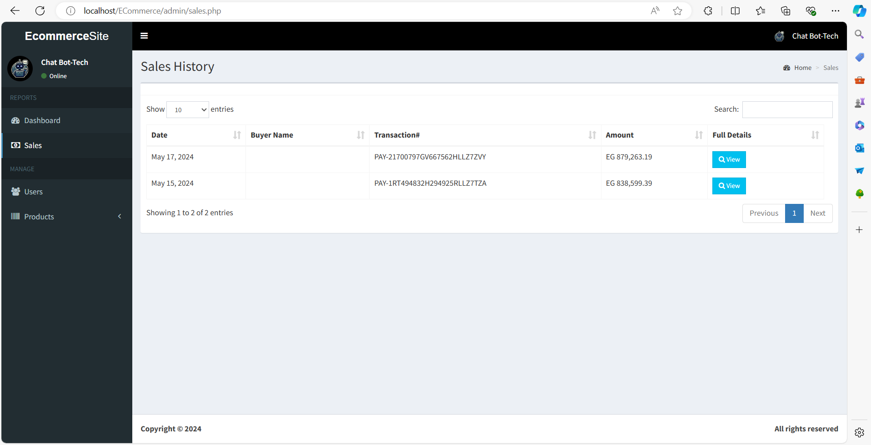

Slide 37
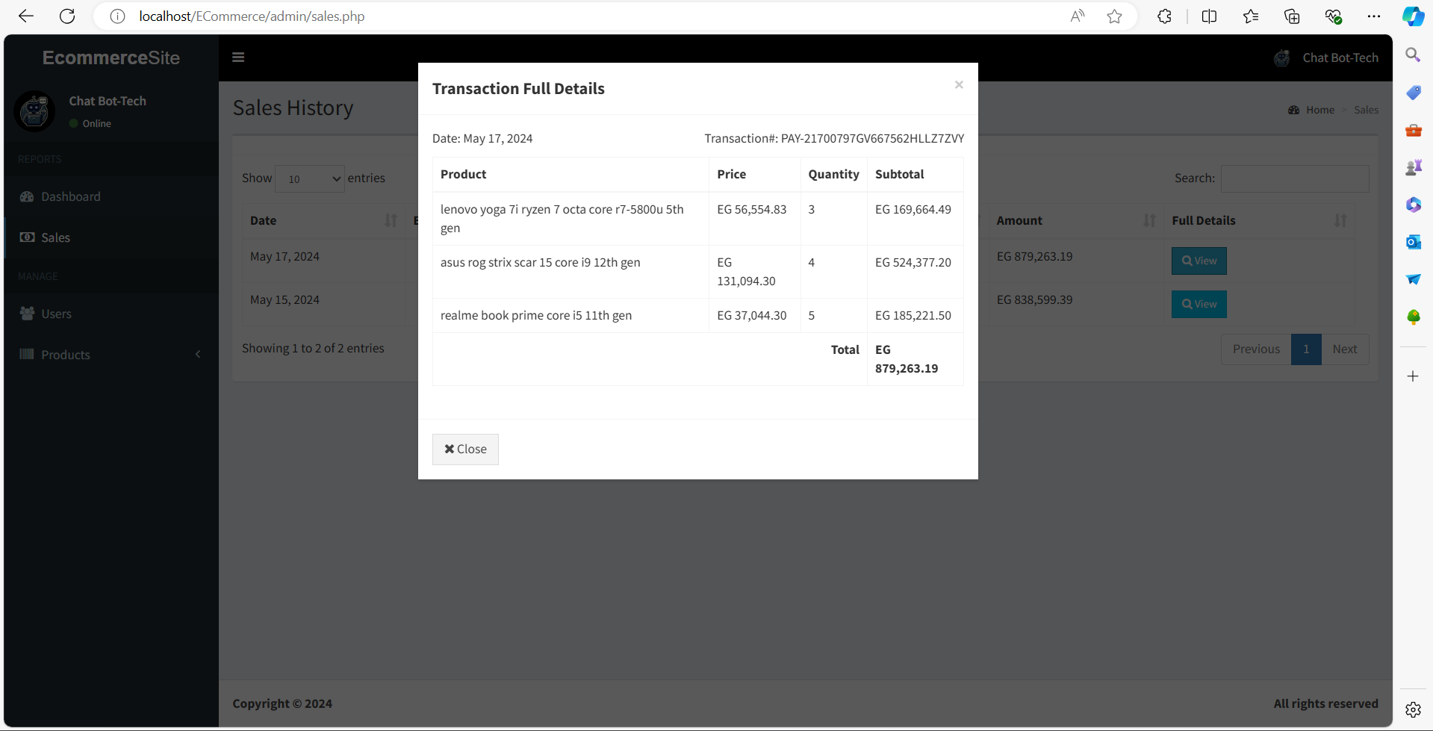

Slide 38
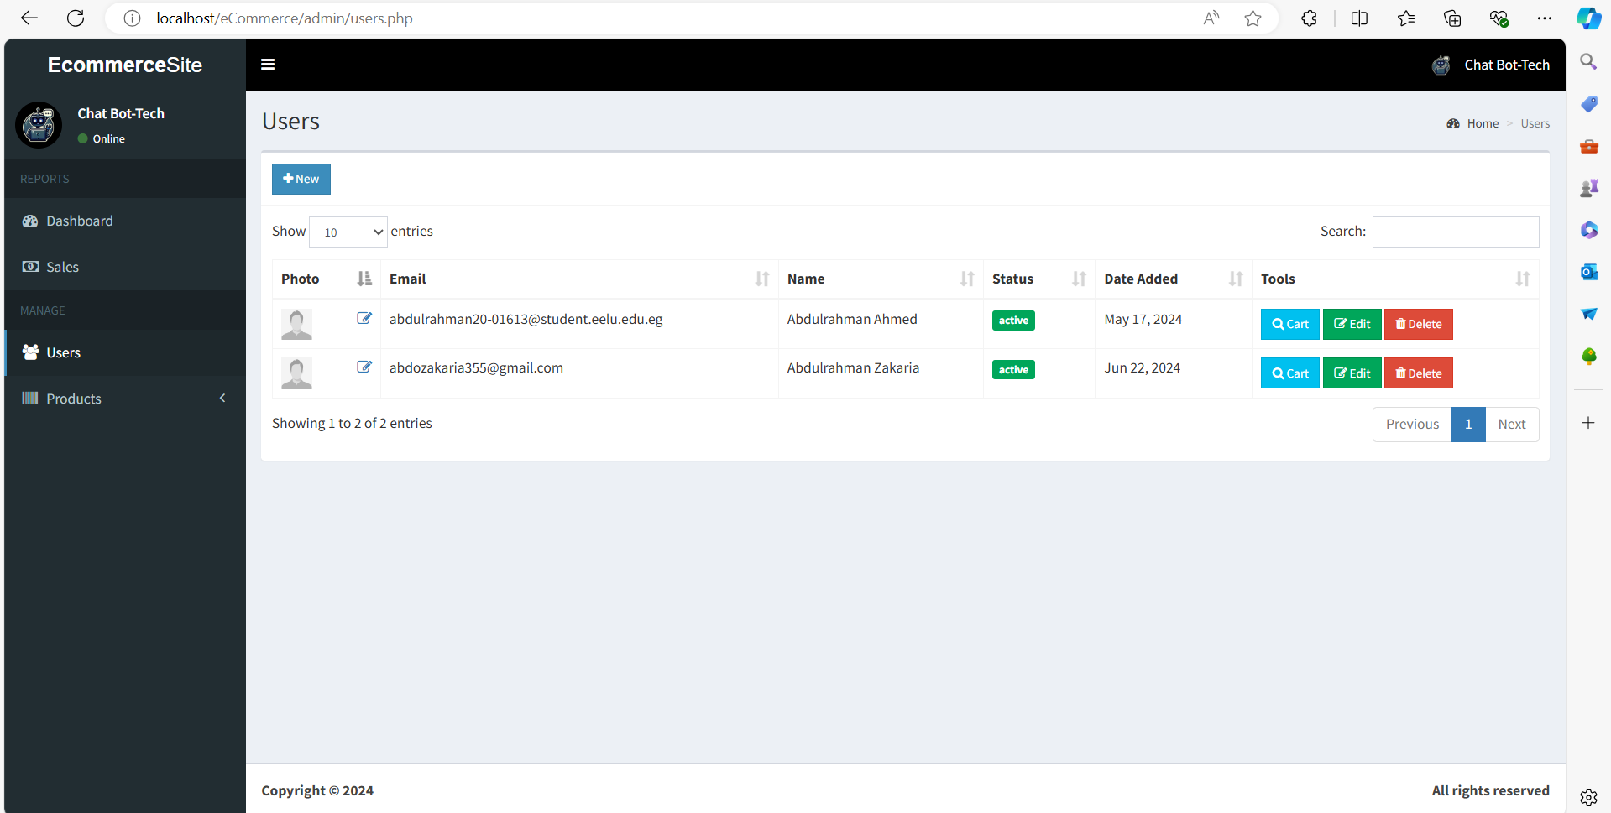

Slide 39
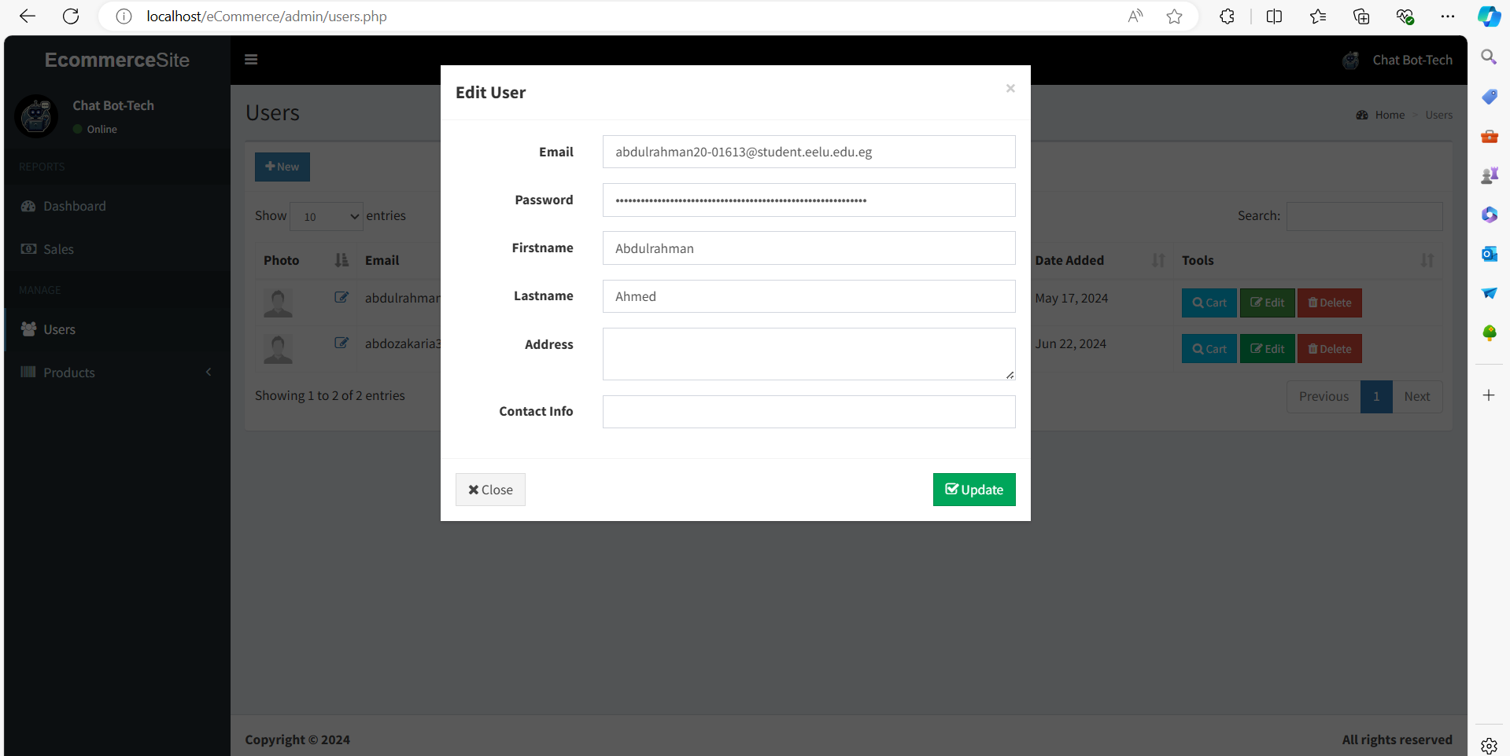

Slide 40
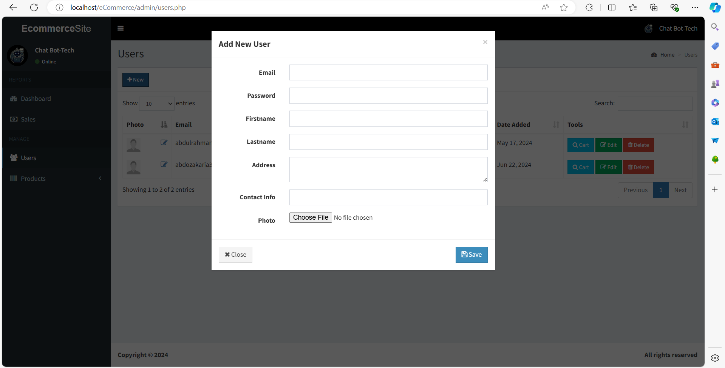

Slide 41
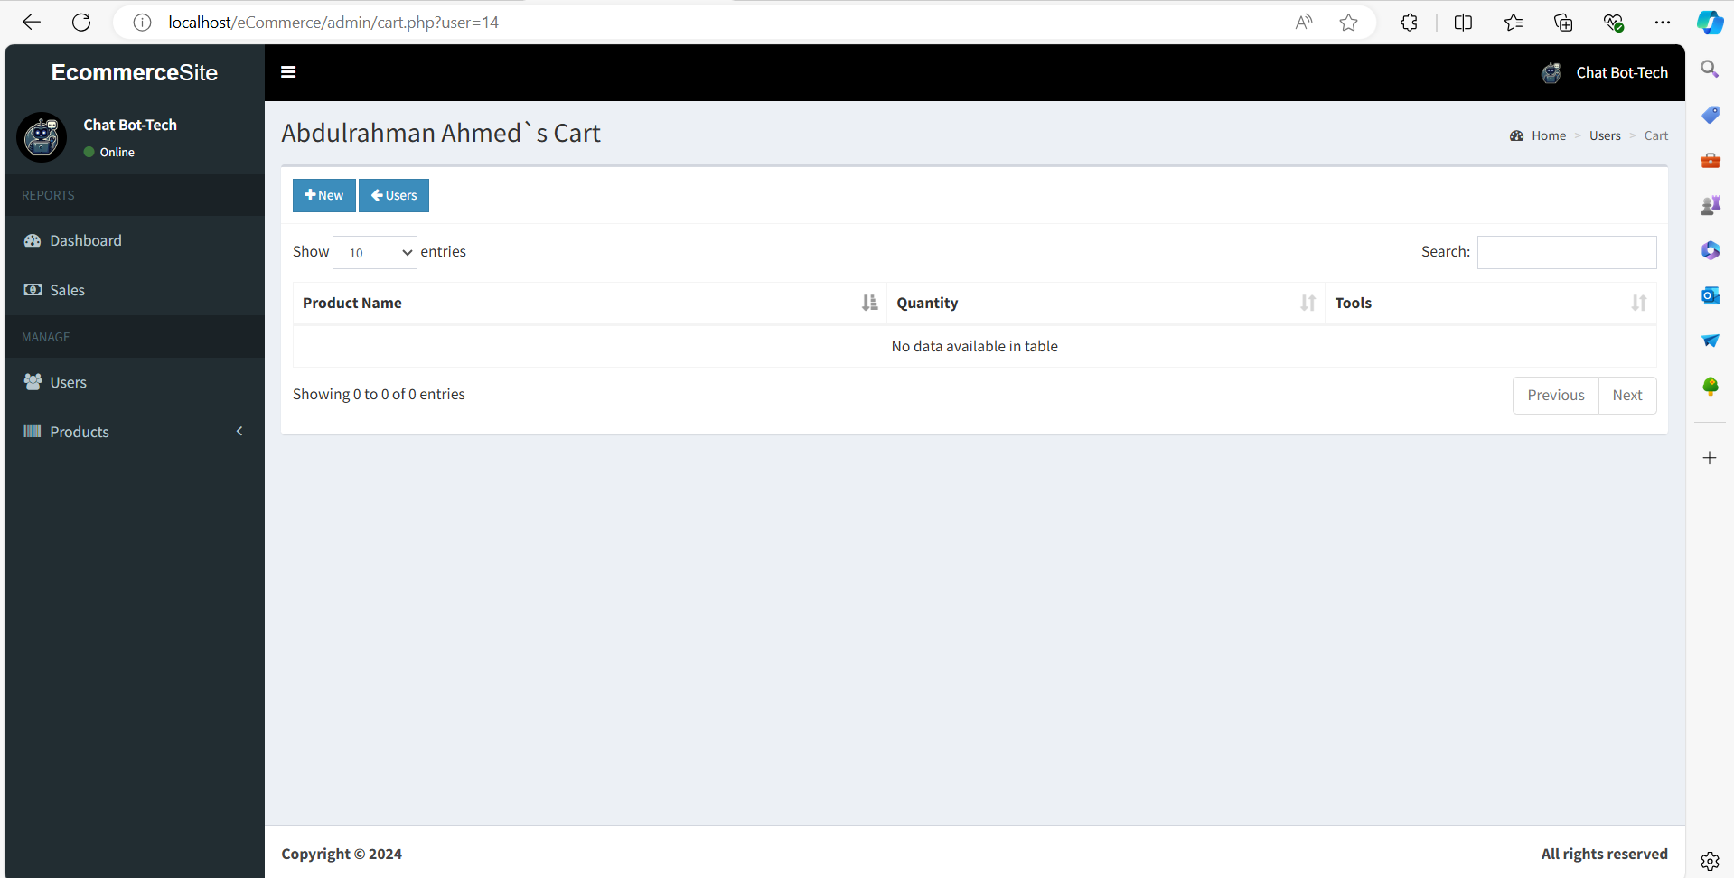

Slide 42
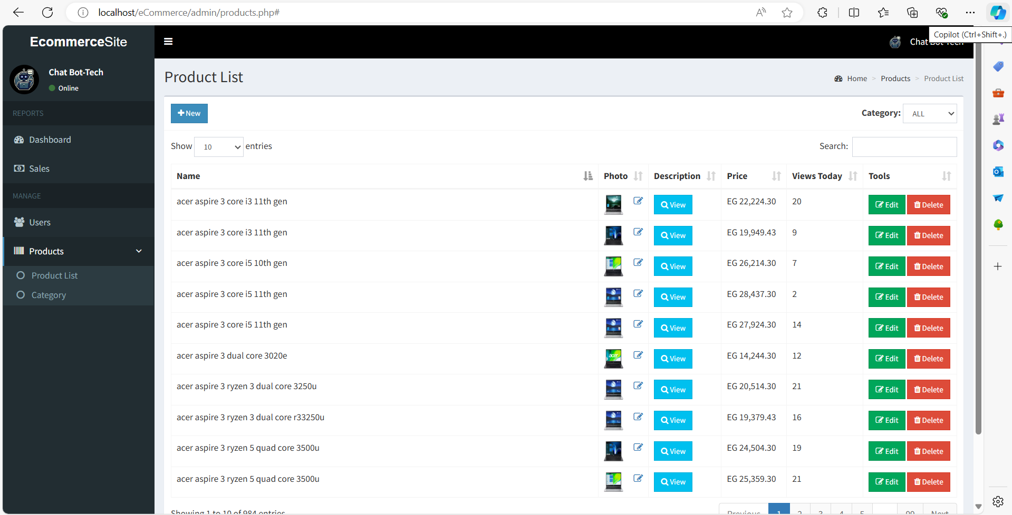

Slide 43
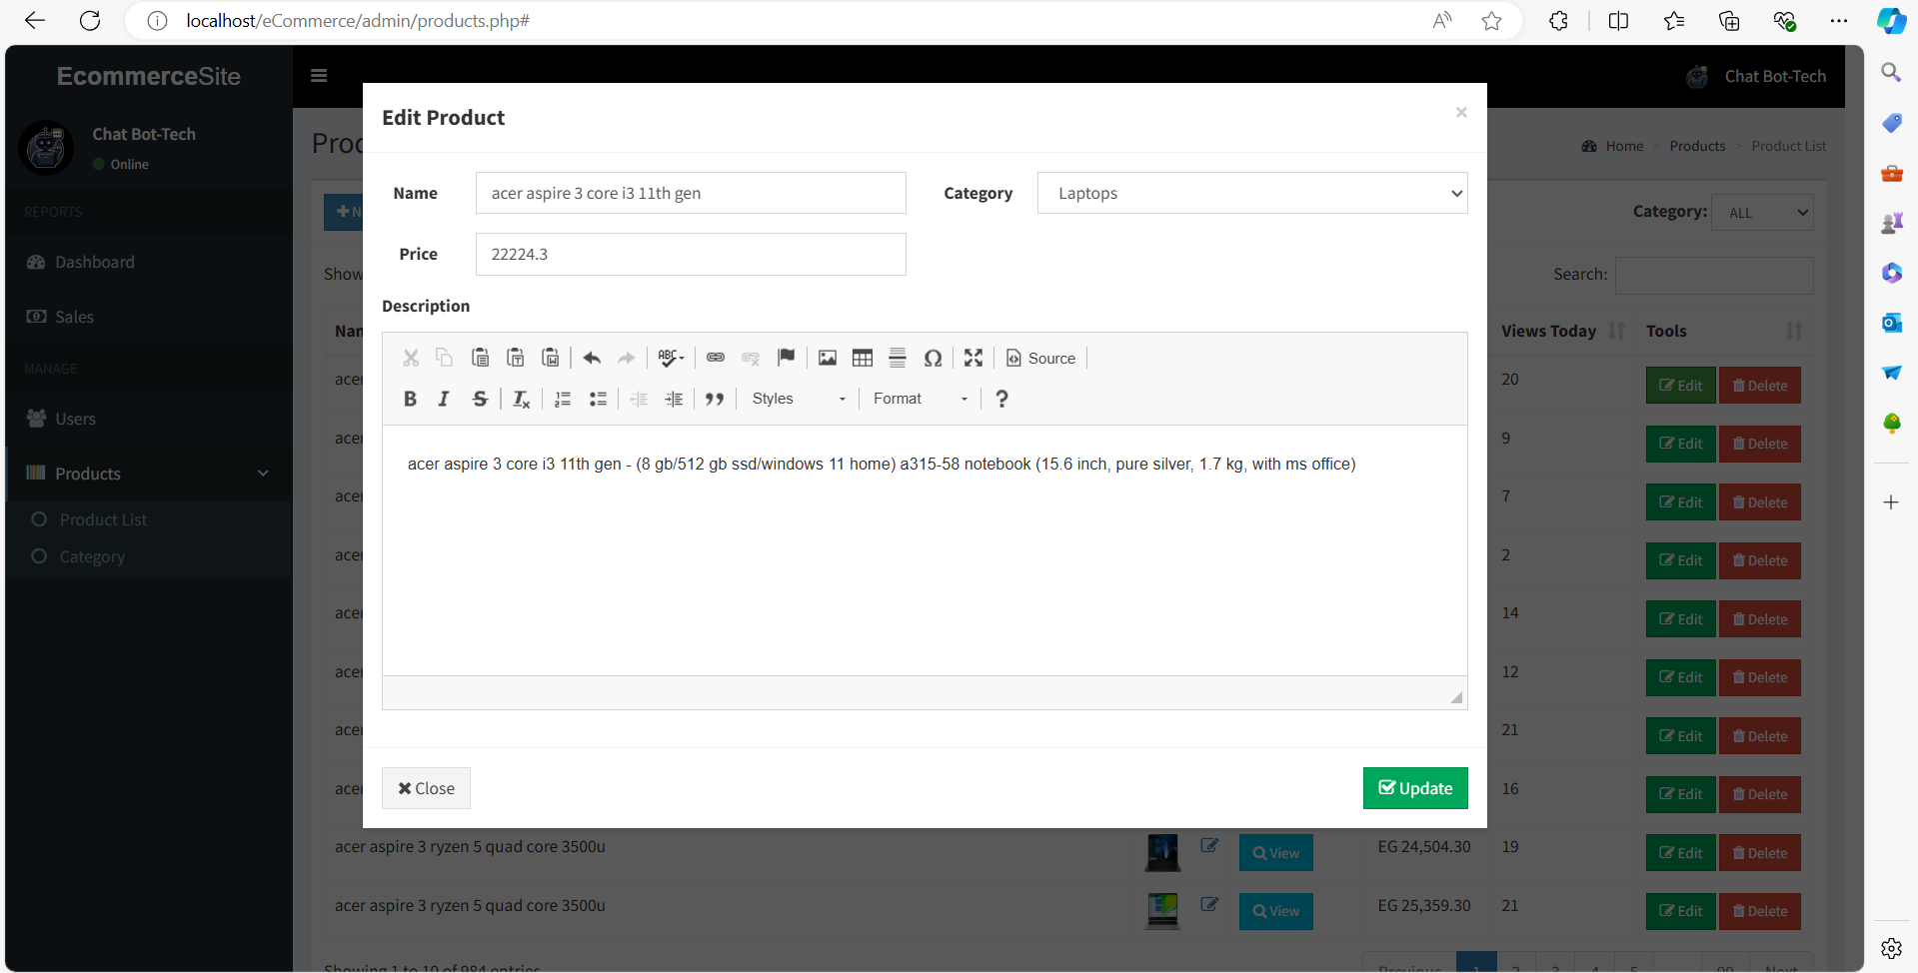

Slide 44
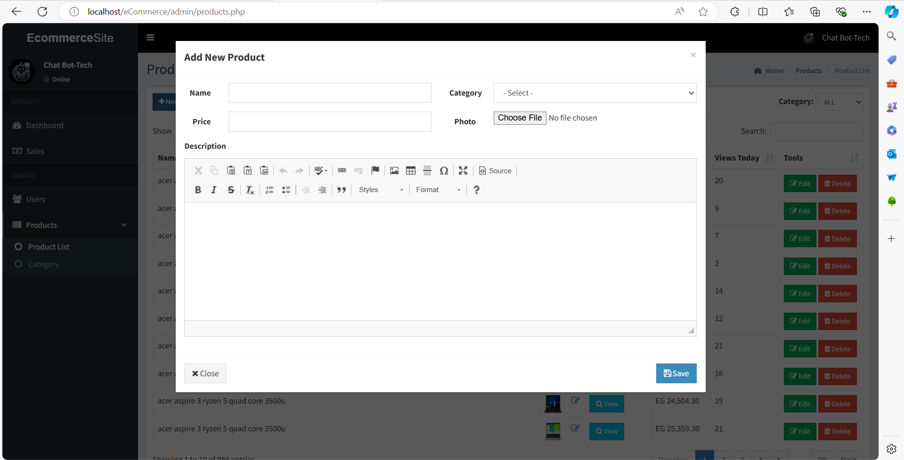

Slide 45
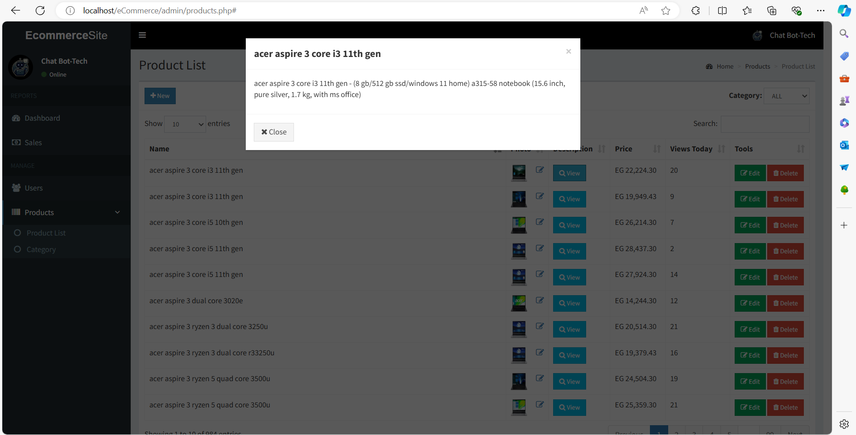

Slide 46
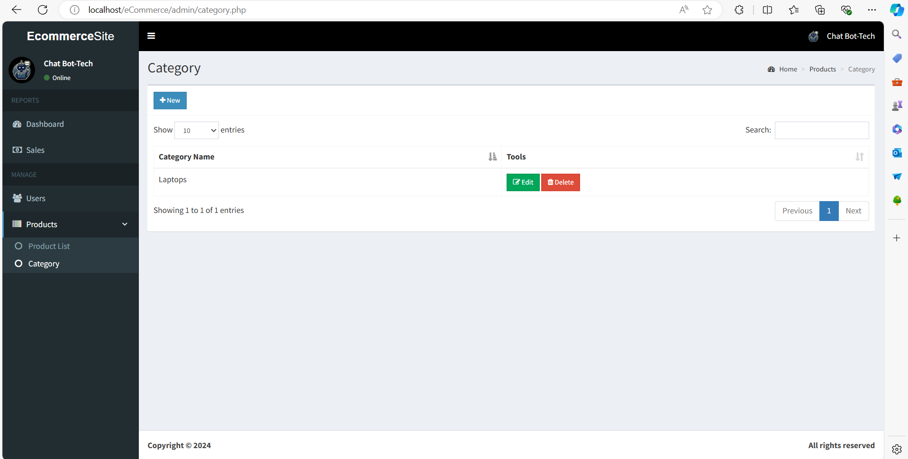

Slide 47
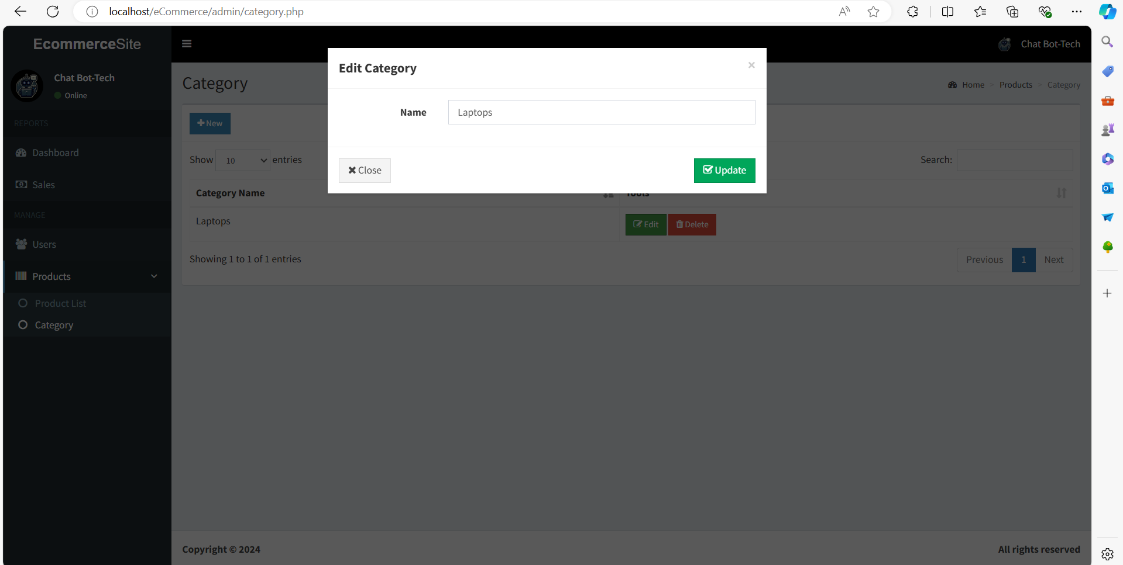

Slide 48
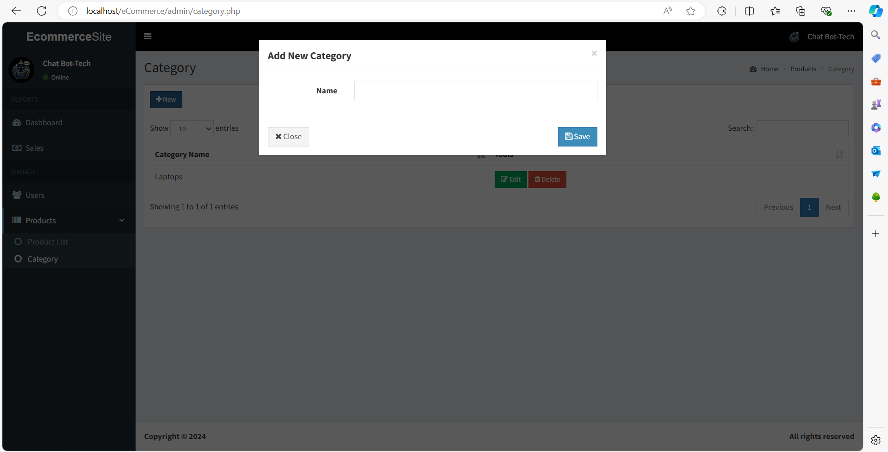

Slide 49
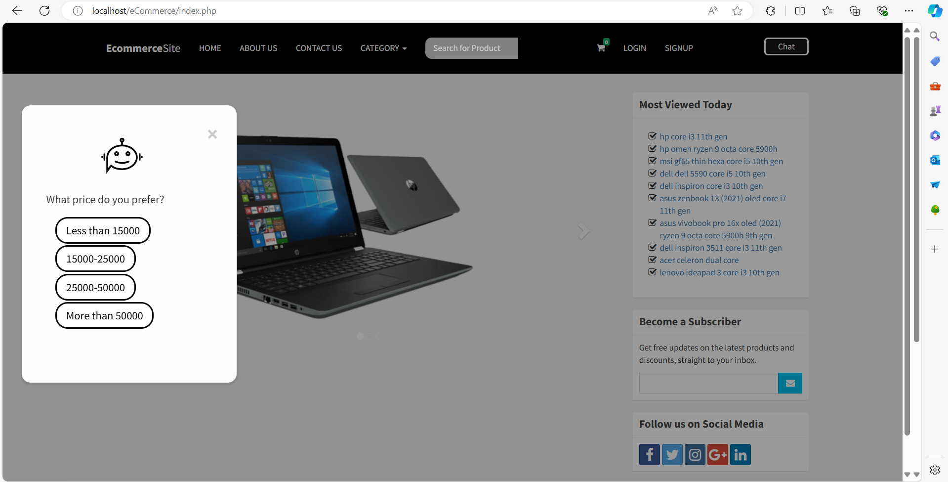

Slide 50
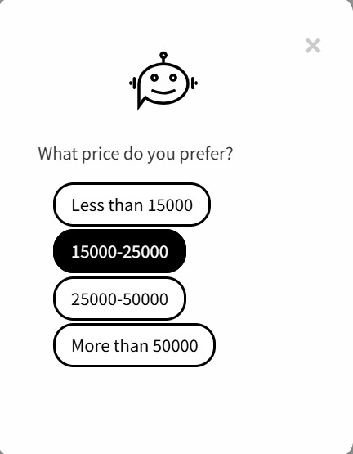
Chatbot questions
Do you need help?
Yes, of course

Slide 51
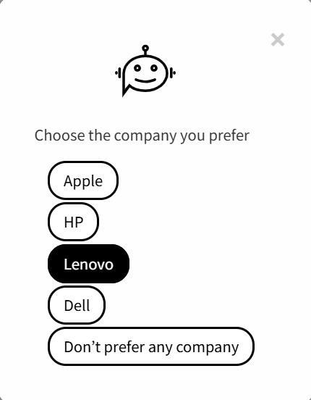
Chatbot questions

Slide 52
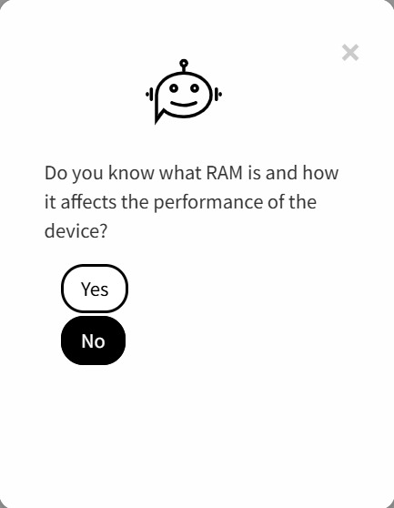
Chatbot questions
Do you need help?
Yes, of course

Slide 53
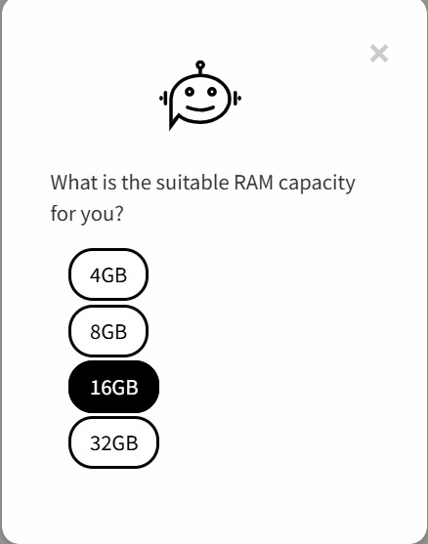
Chatbot questions

Slide 54
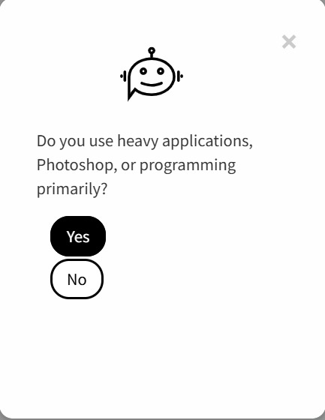
Chatbot questions
Do you need help?
Yes, of course

Slide 55
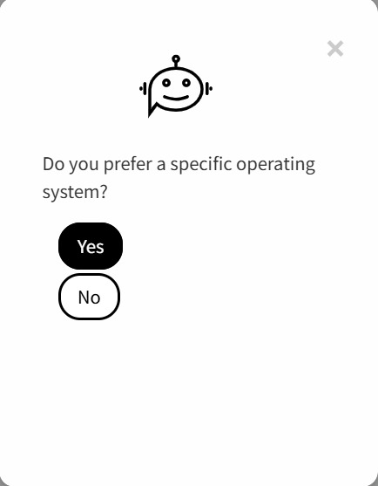
Chatbot questions

Slide 56
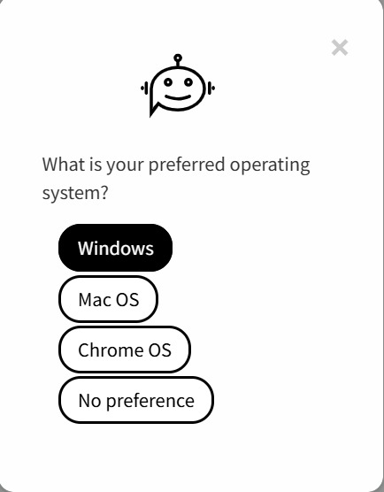
Chatbot questions
Do you need help?
Yes, of course

Slide 57
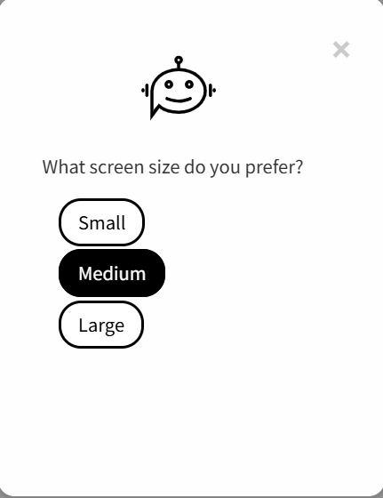
Chatbot questions

Slide 58
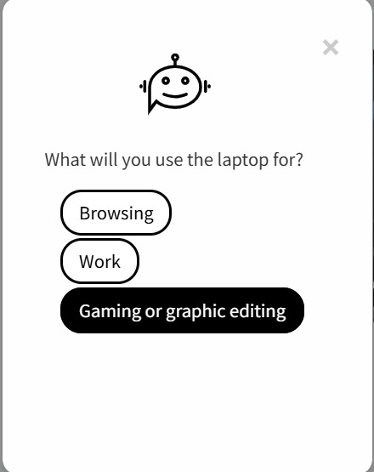
Chatbot questions
Do you need help?
Yes, of course

Slide 59

Chatbot questions

Slide 60
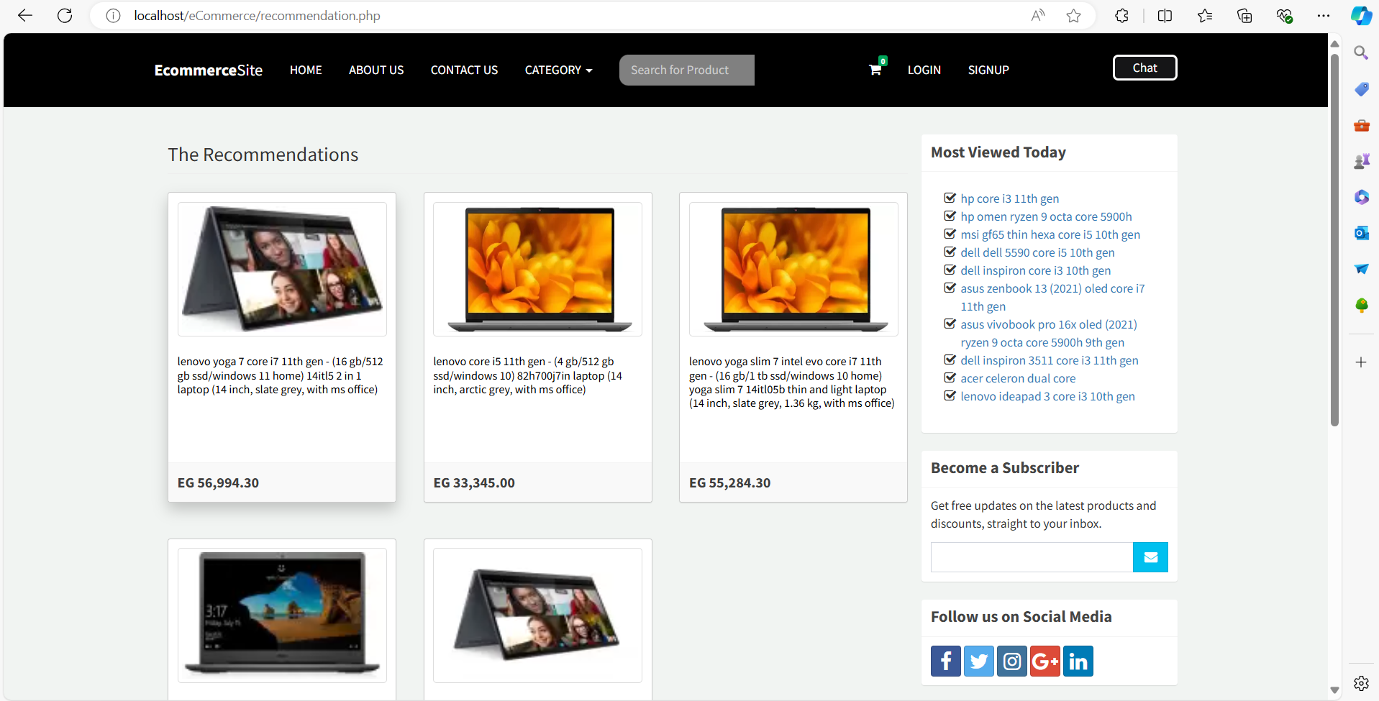

Slide 61
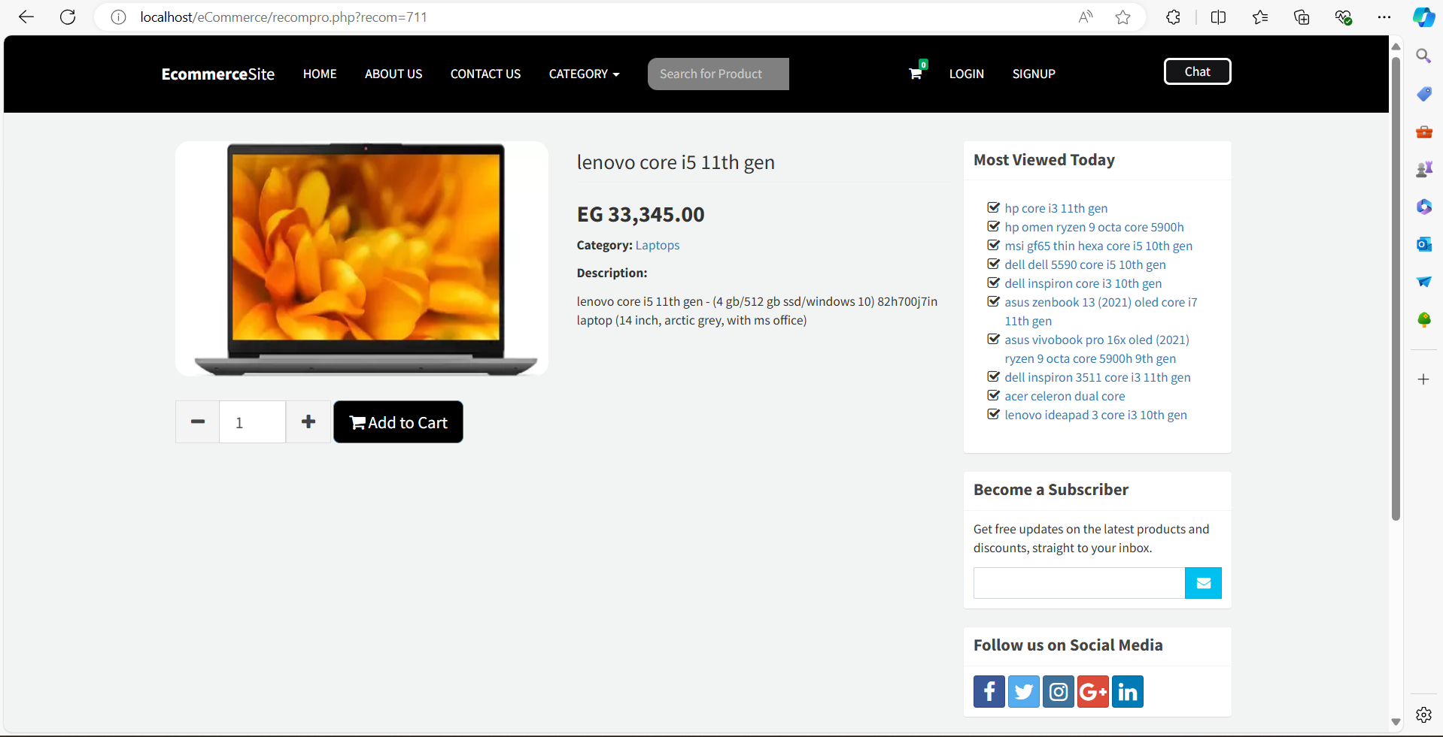

Slide 62
05
Research Objectives

Slide 63
Research Objectives:
The research project endeavors to create a chatbot designed to assist users with limited knowledge of laptop capabilities. Its primary objective is to recommend suitable laptops tailored to individual needs, streamlining the shopping process for those unfamiliar with technical specifications. By offering personalized guidance, the chatbot aims to enhance the overall user experience and simplify the decision-making process when selecting laptops.

Slide 64
06
Time Plan

Slide 65


Nov
Dec
Nov
Apr
Jan
Feb
Mar
May
Idea generation
Research
Prototype
Model
Website

Slide 66
07
Conclusion

Slide 67
Conclusion
1- This project introduces a specialized e-commerce platform for selling laptops, featuring an intelligent chatbot.
2- The chatbot engages users with personalized questions, providing customized laptop recommendations based on preferences.
3- Additionally, users can explore and purchase laptops along with exclusive accessories through the user-friendly online store interface, enhancing the overall shopping experience.
4- Leveraging artificial intelligence, the project ensures accurate and personalized recommendations for laptops.

Slide 68
08
Future Work

Slide 69
Future Work
User Feedback Mechanism:
Improving Data Security and User Privacy
Develop a robust feedback mechanism to capture user satisfaction and areas for improvement directly from the users.
Strengthen data security and user confidentiality.

Slide 70
09
References

Slide 71


References
Roy, Parth, et al. "A Comprehensive Analysis of Recommendation System for E-Commerce Mobile App using various Algorithms." (2021).
Pradeep, N. K. K. R., et al. "Content based movie recommendation system." International journal of research in industrial engineering 9.4 (2020): 337-348.
Kulkarni, Pradnya V., Sunil Rai, and Rohini Kale. "Recommender system in elearning: a survey." Proceeding of International Conference on Computational Science and Applications: ICCSA 2019. Singapore: Springer Singapore, 2020.
Puspasari, Betty Dewi, et al. "Implementation K-Means clustering method in job recommendation system." 2021 7th International Conference on Electrical, Electronics and Information Engineering (ICEEIE). IEEE, 2021.

Slide 72

Any Questions?

